Slide 1
Getting Database Code into a VCS

Slide 2
2.1 – VCS Challenges

Slide 3
The Challenges of Database Code
With SQL Server, the code is never in a file
Every object is a separate code
Lack of tooling

Slide 4
2.2 – Get Code in VCS

Slide 5
Manually Tracking Database Code
File | Open, File | Save (manual tracking)
Cumbersome
Easy to forget
Need a file structure
All objects in one folder (SSMS default)
Schema name folder and object type folder
Object type folders, schema in file name.
Number the script files for execution order

Slide 6
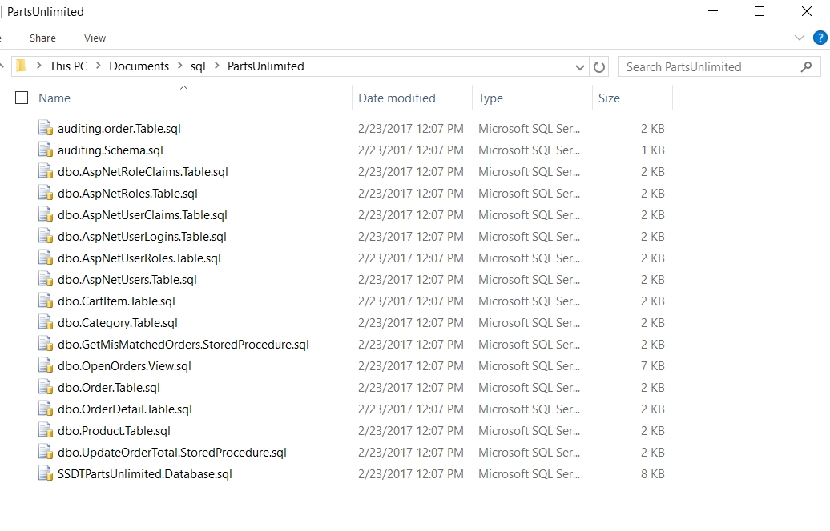

Slide 7
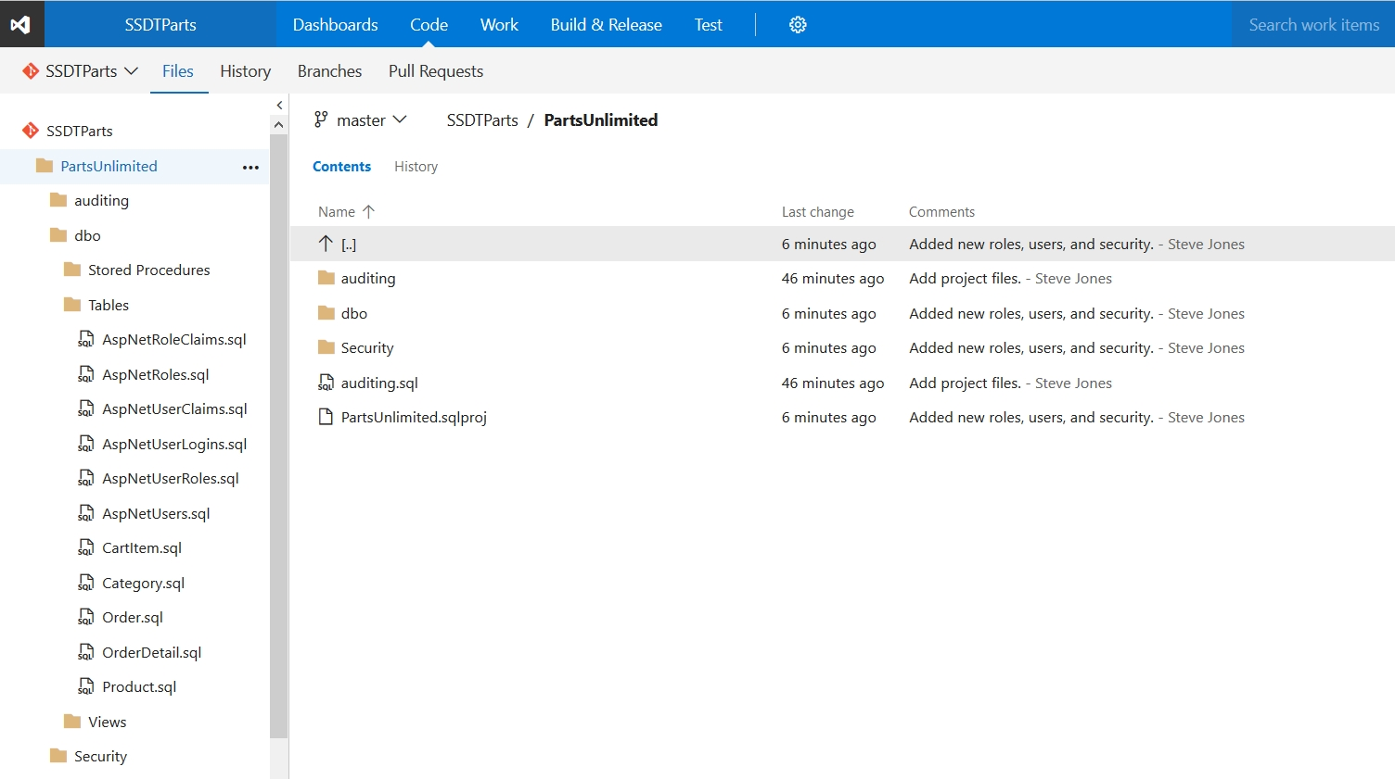

Slide 8
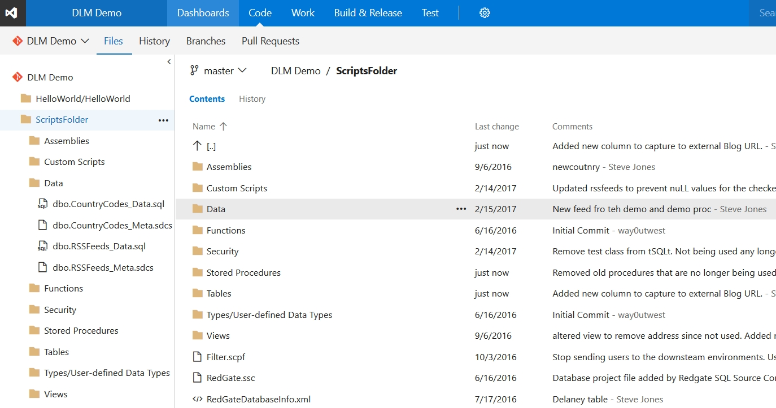

Slide 9
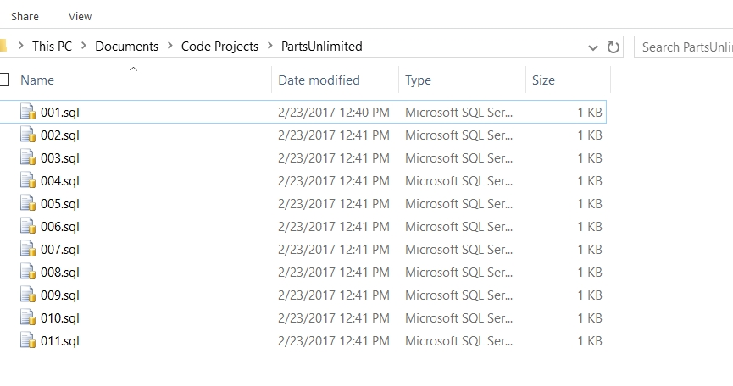

Slide 10
2.3 – What is CI?

Slide 11
What is Database Continuous Integration
Continuous Integation (CI) typically involves
Trigger based on a commit to source control
Automatically compiling all code (build)
Executing automated tests
Publish a release candidate of the compiled code.

Slide 12
What is Database Continuous Integration
For state based database development
Trigger based on code commit to source control
Recompile all code on a database (build)
Run automated tests
Publish a package containing the current versions of all code
For migration based development
Run a project build to validate all scripts
Run automated tests
Publish a package containing the upgrade scripts needed for the target database (or all migration scripts).

Slide 13
2.4 – Continuous Testing

Slide 14
Testing in Database Continuous Integration
Standards and Static Code Analysis
Unit Tests
Functional Testing
Performance Testing
Security Testing

Slide 15
Standards and Static Code Analysis Tests
These are tests to ensure that code is consistent.
Can include naming, DRI, index requirements, poor programming patterns and more.
Testing Tools
SQL Cop - http://sqlcop.lessthandot.com/
SQL Code Guard - https://sqlcodeguard.com/
SQL Enlight - http://www.ubitsoft.com/products/sqlenlight/

Slide 16
Unit Tests
Unit tests are designed to test individual sections of code.
Test stored procedures, functions, and assemblies in isolation.
Data is always consistent in a unit test
Tools
Microsoft Unit Testing
tSQLt

Slide 17
Other Tests
Functional Tests
Tests multiple sets of code as one unit, i.e. a stored procedure that calls a function and updates a table.
May include application code test that affect the database
Performance (Load) Tests
Need production sized (or larger) data sets
Should simulate a production (or larger) workload
Maybe run less frequently
Security Tests
Ensure access is limited
More complex to write when roles are not used for assigning rights

